Slide 1
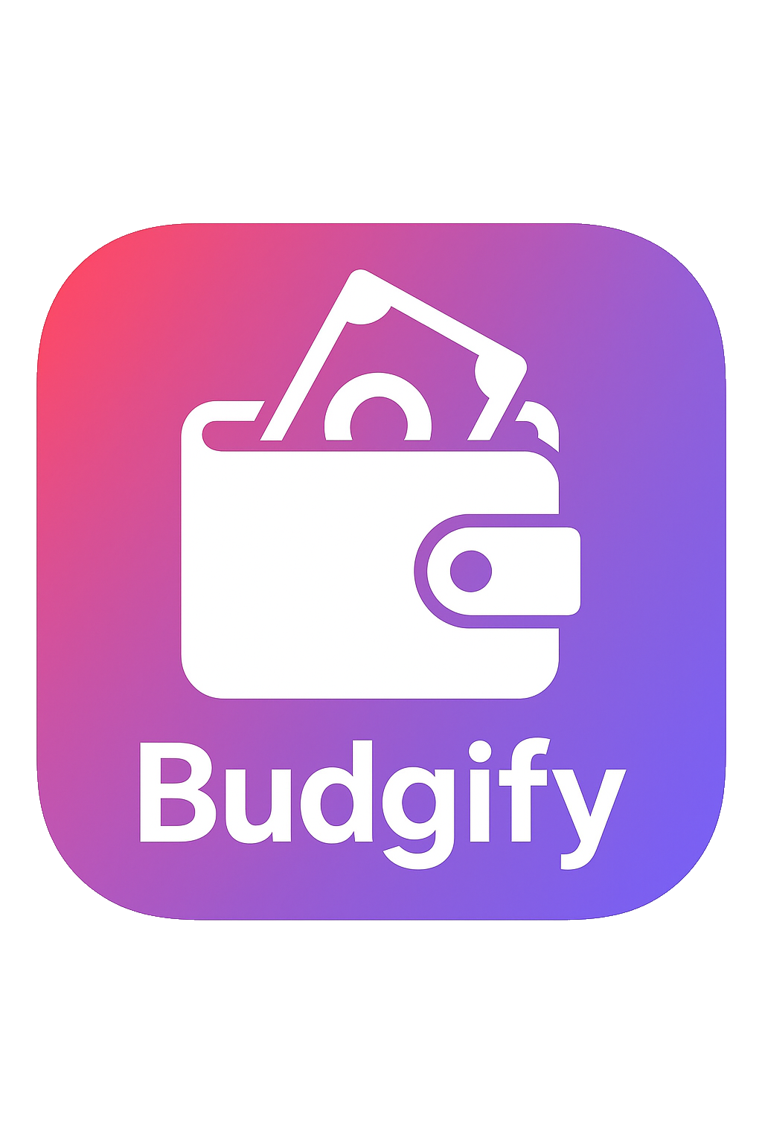
Your personal finance manager
Alessandro Catalano
Alessandro Rocchi
Onorio Iacobelli
Human-Computer Interaction
A.Y. 2024/2025

Slide 2
Introduction
Budgify is your all-in-one personal finance companion designed to make managing money both effective and engaging.
With Budgify, you can effortlessly track expenses by recording every transaction, set financial goals to stay motivated, and manage loans with ease.
What sets Budgify apart is its leveling system that turns budgeting into a rewarding experience. You can earn points by completing tasks to earn rewards as you use the app.

Slide 3

Personas and scenarios
ALEX JAMESON
Alex is an ambitious and forward-thinking university student. He’s disciplined in his studies and works part-time, but struggles with self-control when it comes to impulsive spending. He values freedom and sees owning a car as a symbol of personal success and responsibility.
Scenario
Alex dreams of buying his first car but feels overwhelmed trying to balance his school workload, part-time job, and unpredictable spending habits.
When he starts using Budgify, he sets a specific saving goal for his car. Seeing his progress visually keeps him motivated and focused.
Alex becomes more aware of his habitual takeout expenses. He also gains a stronger sense of control in his financial decisions, ultimately purchasing his car without compromising his long-term security.

Slide 4
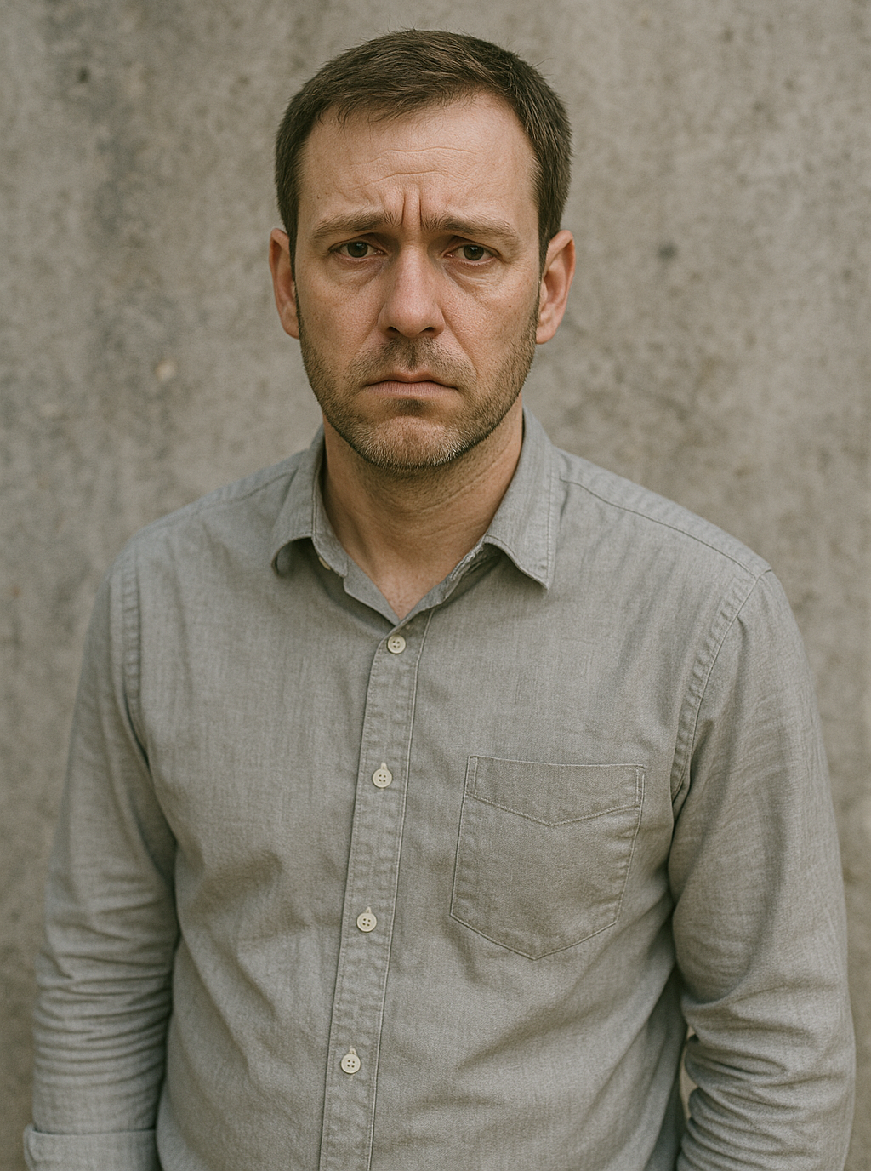
Personas and scenarios
JAMES CARTER
James is a practical and resilient individual in his late 30s who thrives on stability. When he loses his job, his initial reaction is anxiety, bordering on hopelessness. Internally. However, James is also adaptive and willing to rebuild.
Scenario
After being unexpectedly laid off, James turns to Budgify to regain a sense of direction and clarity.
Budgify helps James analyze his emergency fund and sets a realistic timeline for how long his current savings will last.
As he begins freelancing, James uses Budgify to categorize different income sources, track tax-related expenses, and manage invoices.
He rebuilds his confidence and navigates unemployment with purpose, eventually stabilizing his finances.

Slide 5

Personas and scenarios
MARGARET ”MAGGIE” THOMPSON
Maggie is a lively, optimistic retiree. She’s careful with money but believes in enjoying the fruits of her lifelong labor. She’s curious, enjoys planning, and takes pride in managing her finances herself rather than relying on her children.
Scenario
With a long-anticipated cruise around the Mediterranean on the horizon, Maggie wants to enjoy herself without falling into careless spending.
Maggie uses Budgify to create a personalized trip budget, dividing expenses into categories like travel, lodging, excursions, and on-board spending.
During the trip, Budgify tracks her spending in real time when buying meaningful souvenirs while skipping unnecessary extras.
Maggie enjoys her cruise worry-free, proud of having full control over her finances, and returns home with wonderful memories, not debt.

Slide 6
User analysis - interviews
The feedback from the interviews with our users can be synthesized into:
Simplicity and Ease of Use: many current applications are perceived as ”too confusing”, ”overcomplicated” or having a cluttered interface
Intuitiveness: users want an app that is intuitive from the start, allowing for quick and easy use and visualization
Engagement: many users focus on personal goals, wanting to track their progress towards them and to receive rewards for reaching them

Slide 7
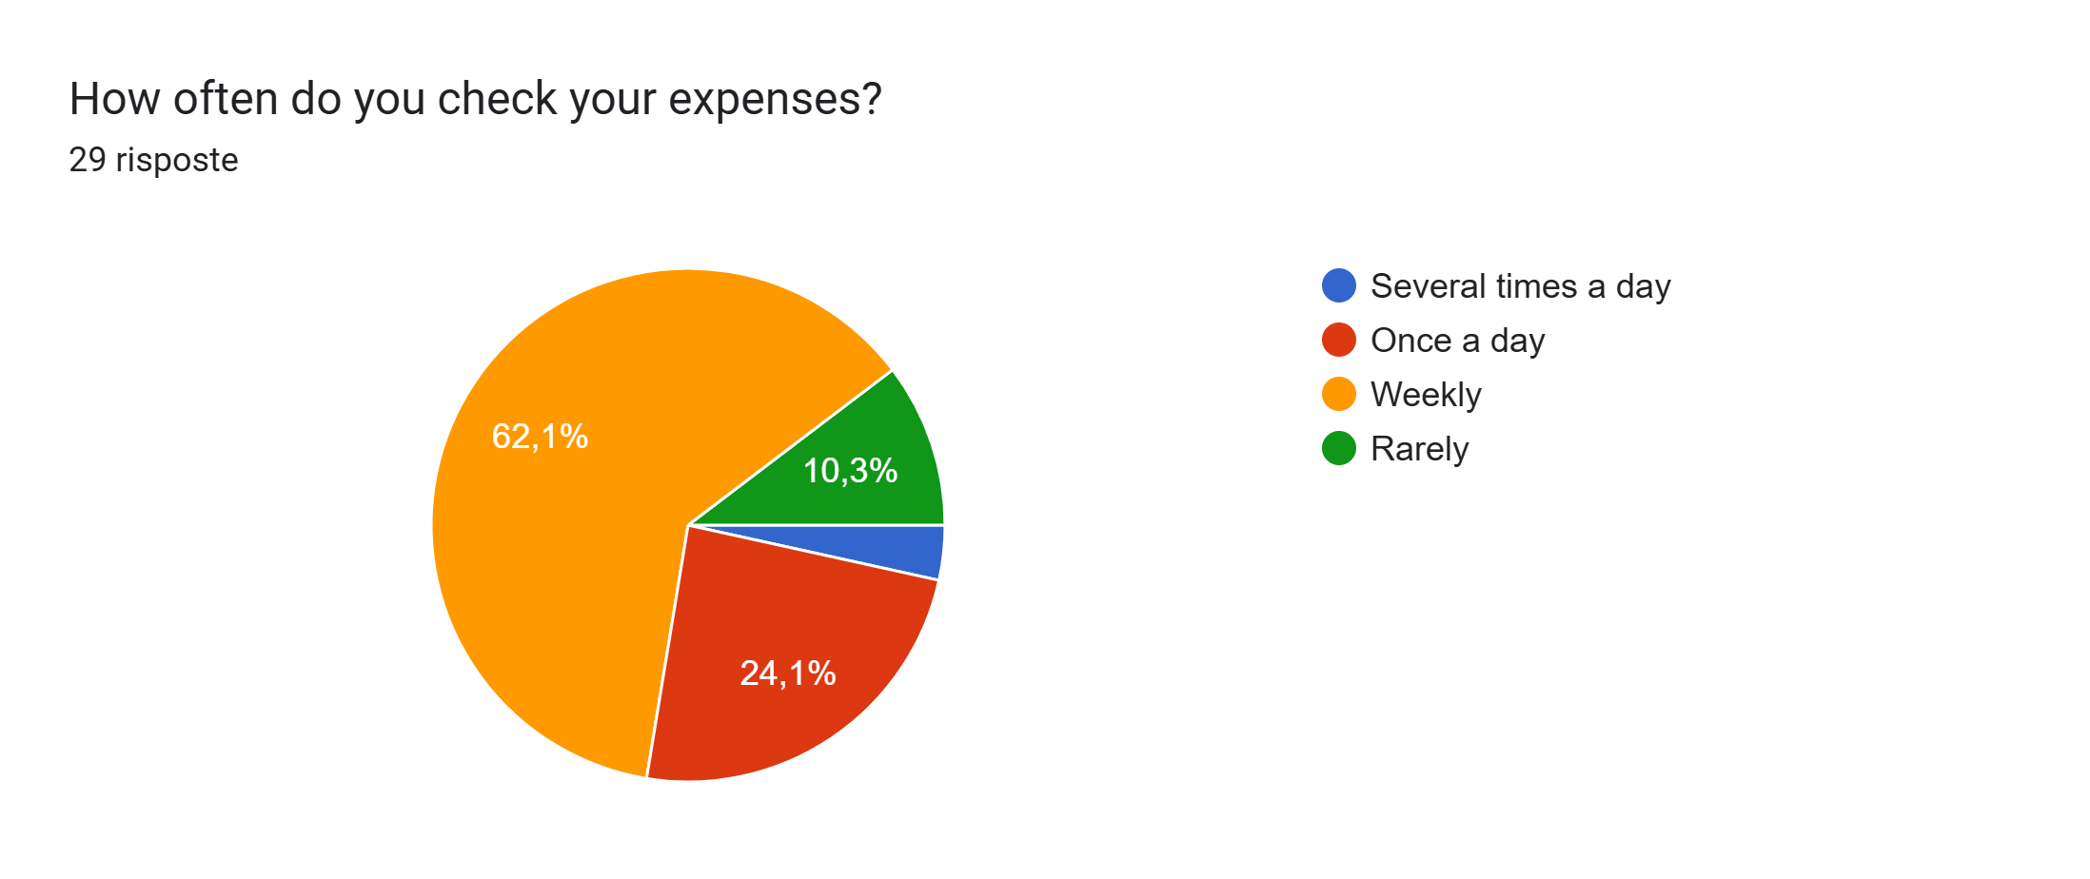
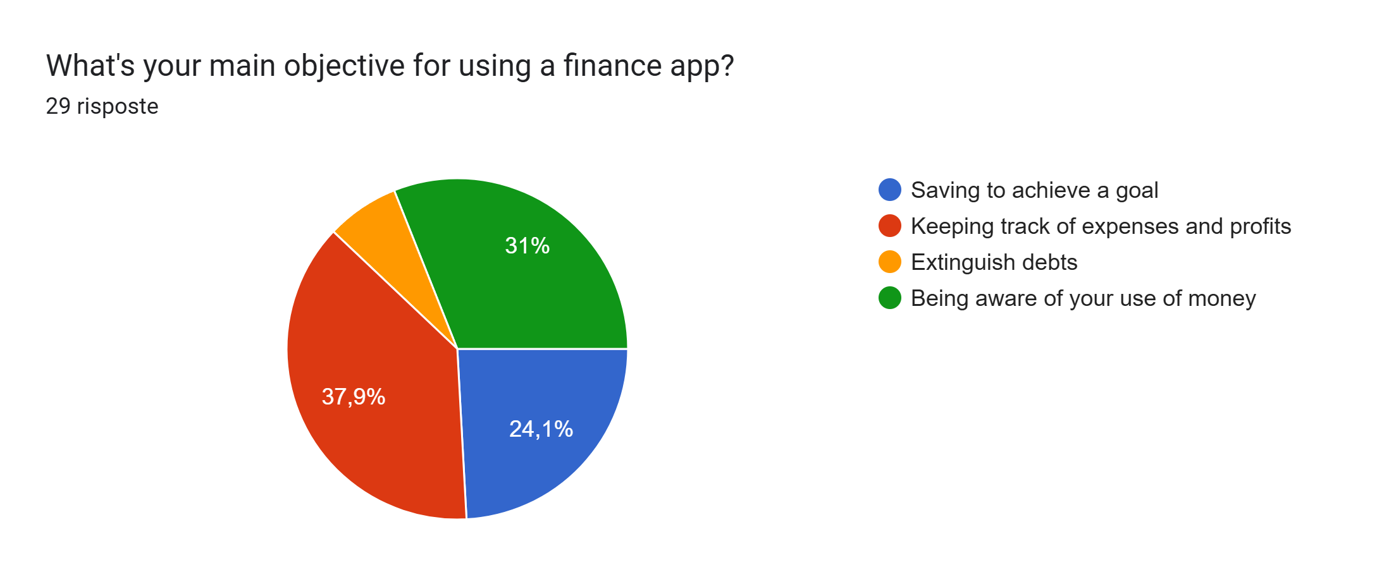
User analysis - questionnaires
We administered a questionnaire to our potential users. Here are some of the insights we gained from it.
Many users tend to check expenses on a weekly basis
They want to keep track of their expenses in order to be aware of their use of money
They also like to keep track of goals and debts
From this, we were able to get an idea of the general use of the app.

Slide 8
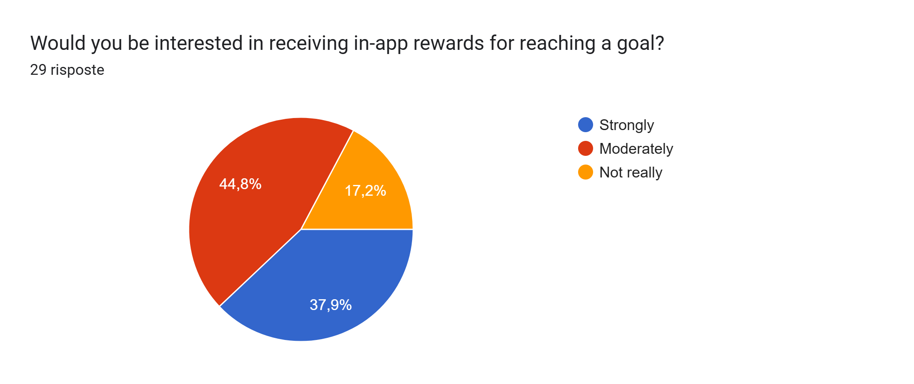
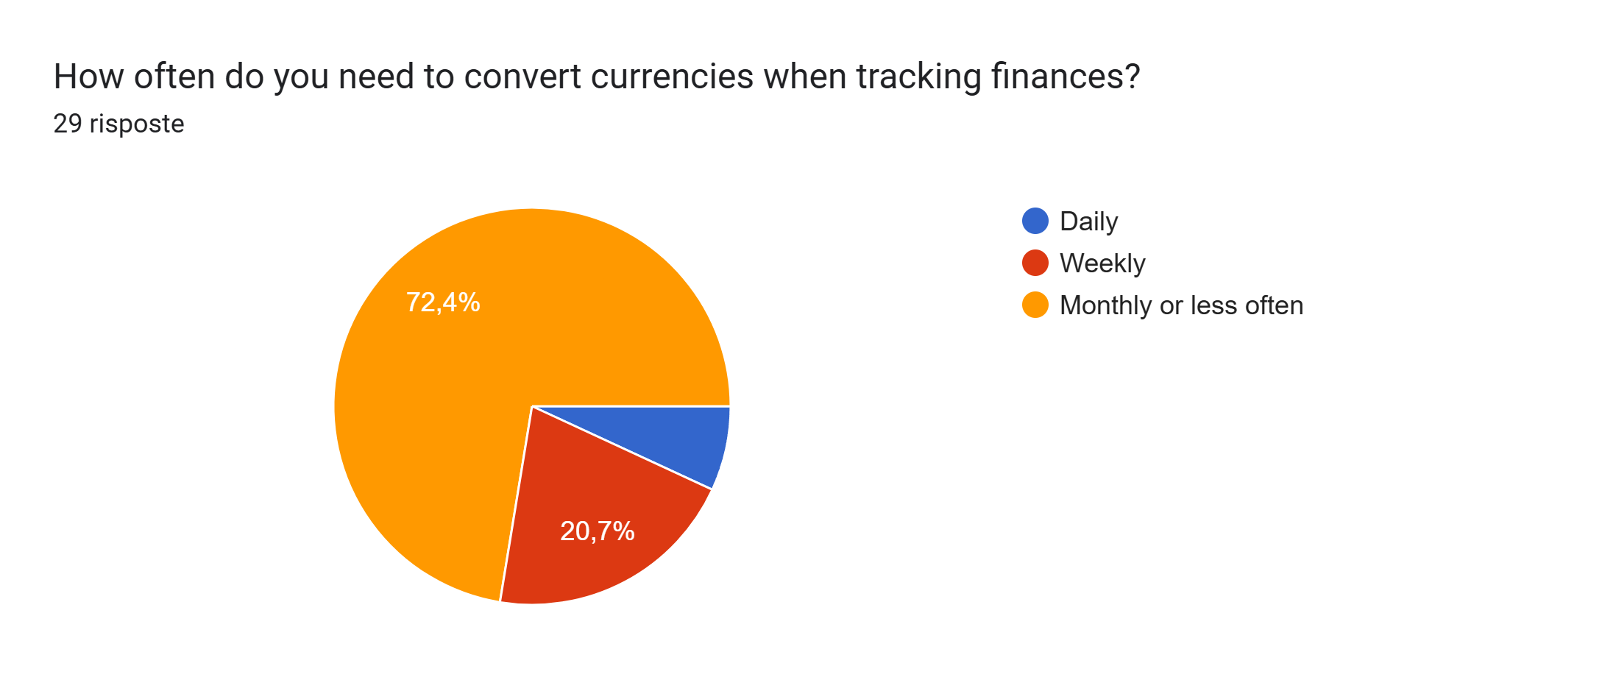
User analysis - questionnaires
Through the questionnaire we were also able to decide which features to develop depending on the preference of the users. We noticed that
Users like receiving in-app rewards for reaching set goals
They do not need to convert currencies often
Because of this, we decided to implement a leveling system with rewards in our app and we abandoned the idea of inserting a currency conversion feature.

Slide 9



Competitor analysis
From the results of the questionnaires and by looking at the most popular finance apps we were able to find some apps that users currently utilize to track their expenses. We’ve compared the features offered by said apps with the ones offered by Budgify
App | Expense tracking | Categories | Loans | Charts | Reward system | Secure access
Budgify
Budget e finanze
Splitwise
Money manager
1Money
PRO
LIMITED
(Most apps only offer one type of chart)

Slide 10
Hierarchical task analysis
0: Buy and item and record the expense
Plan 0: In order 1,2,3,4
Plan 2: In order 2.1,2.2,(2.3 or 2.4)
1: Decide what to buy
2: Find a shop
3: Buy the item
Plan 3: 3.1 or 3.2
4: Register the transaction
Plan 4: One between 4.1,4.2,4.3
Then 4.4
2.1: Look for shops that sell the item
2.2: Choose a shop
2.3: Go to the physical store
2.4: Visit the online shop
3.1: Pay with cash
3.2: Pay with card
4.1: Use a budgeting tool
4.2: Use an app
4.3: Write the transaction down
4.4: Write the transaction details

Slide 11
Hierarchical task analysis
0: Set a goal and buy the related item
Plan 0: In order 1,2,3 Then, if no, do 4 Then do 5
Plan 2: In order 2.1,2.2
Plan 4: Do 4.1,4.2,4.3 until money is enough
1: Choose what you want to save for
2: Set a goal
3: Check if you can afford the item
4: Save money
5: Buy the item
Plan 2.2: 2.2.1 or 2.2.2
Plan 3.1:
3.1.1 and/or 3.1.2
Plan 3.2:
3.2.1 or 3.2.2
2.1: Identify the price of the item
2.2: Record the details of the item
3.1: Check if you have enough money
3.2: Check if you have any debts
Plan 4.3:
4.3.1 or 4.3.2
4.1: Cut down on expenses
4.2: Put aside earnings
4.3: Keep track of saved money
2.2.1: Use an app
2.2.2: Write them down
3.1.1: Check your cash
3.1.2: Check your bank account
3.2.1: Check with an app
3.2.2: Check a list
4.3.1: Use an app
4.3.2: Write it down

Slide 12
Hierarchical task analysis
0: Extinguish a debt
Plan 0: In order 1,2 Then, if no, do 3 Then do 4
Plan 1: In order 2.1,2.2
Plan 2: In order 2.1,2.2
Plan 3: Do 3.1,3.2,3.3 until money is enough
Plan 4: 4.1 or 4.2
1: Identify the debt
2: Check if you can repay the debt
3: Save money
4: Repay the sum
Plan 1.1: 1.1.1 or 1.1.2
Plan 2.1:
2.1.1 and/or 3.1.2
Plan 2.2:
2.2.1 or 2.2.2
1.1: Check your debts list
1.2: Find the debt
2.1: Check if you have enough money
2.2: Check if you have any debts
4.1: Set up an appointment
4.2: Pay with bank account
3.1: Cut down on expenses
3.2: Put aside earnings
3.3: Keep track of saved money
4.1.1 Pay with cash
1.1.1: Check an app
1.1.2: Check a physical list
Plan 3.3:
3.3.1 or 3.3.2
2.1.1: Check your cash
2.1.2: Check your bank account
2.2.1: Check with an app
2.2.2: Check a list
3.3.1: Use an app
3.3.2: Write it down

Slide 13
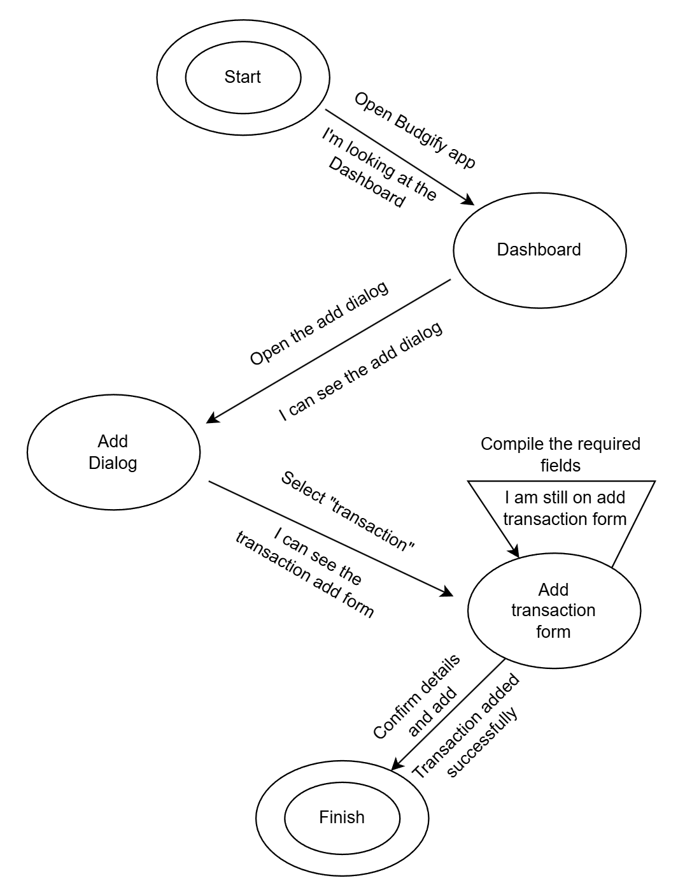
State transition networks
This is the STN related to the “Buy an item and record the expense “ HTA

Slide 14
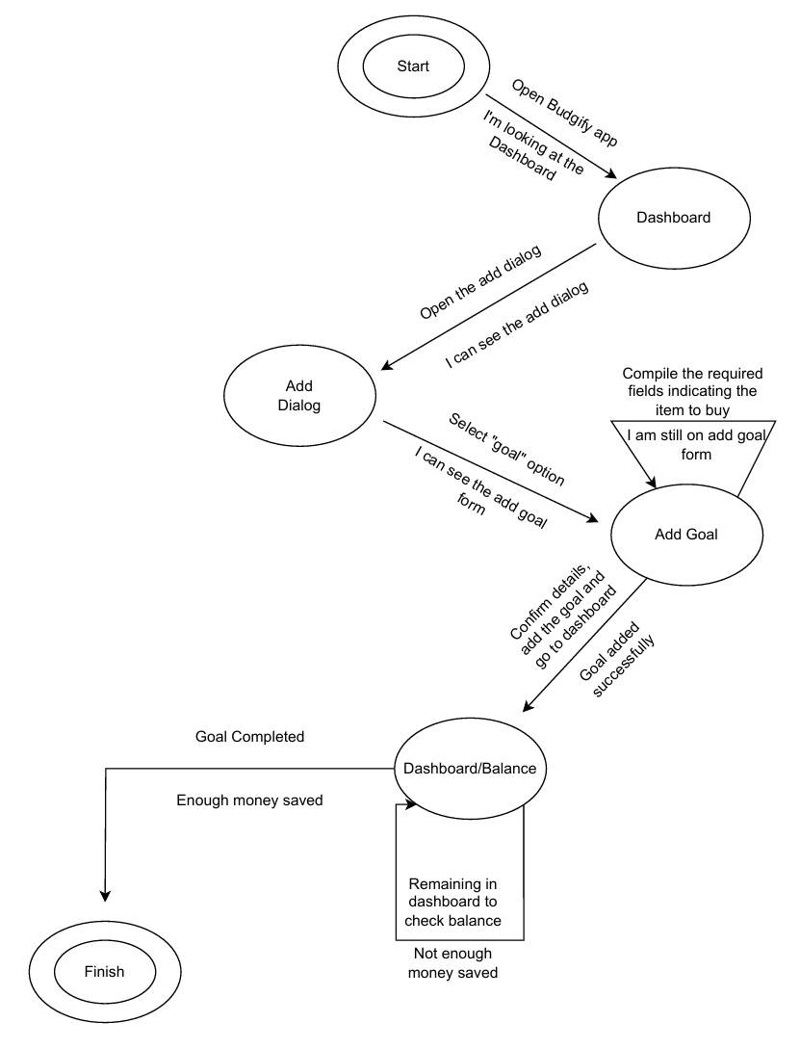
State transition networks
This is the STN related to the “Set a goal and buy the related item“ HTA

Slide 15
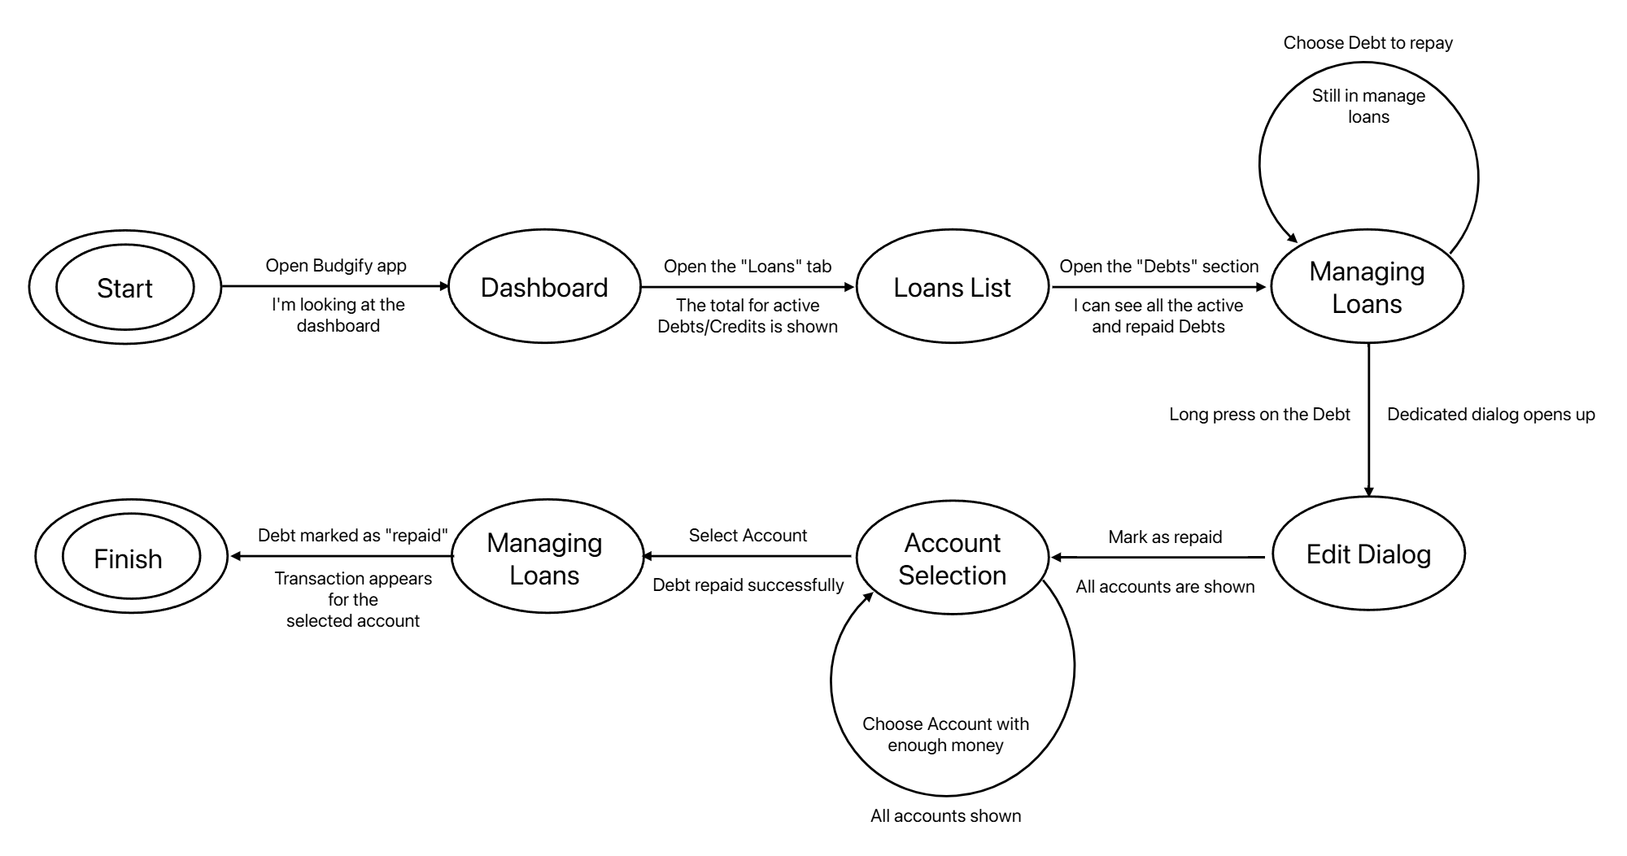
State transition networks
This is the STN related to the “Extinguish a debt“ HTA

Slide 16
Conclusion analysis
In conclusion, the analysis indicates a clear user need for a comprehensive and goal-oriented financial tool.
The main features to include are:
Rewarding goals
Debts and credits handling
Listing of transactions
Handling of multiple accounts
Clear visualization of data

Slide 17
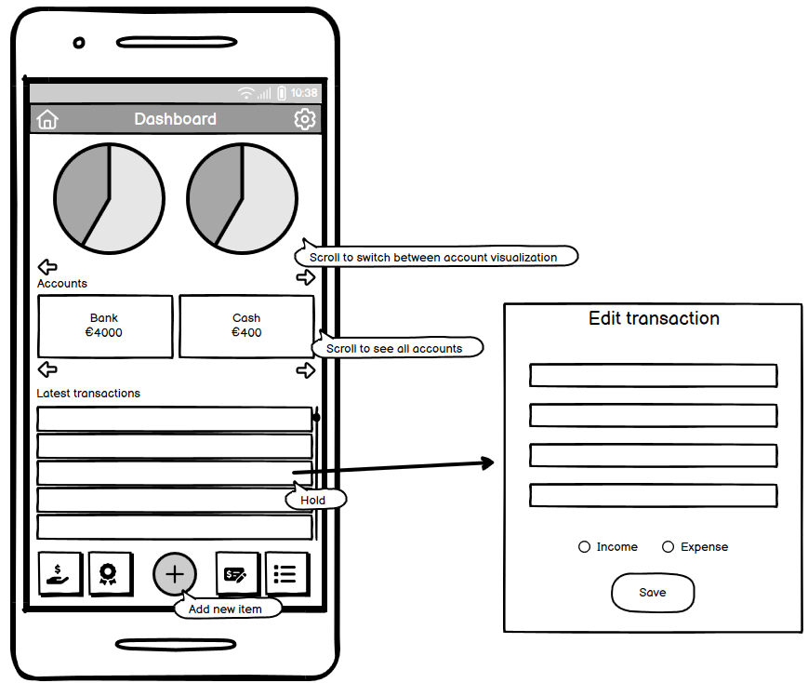
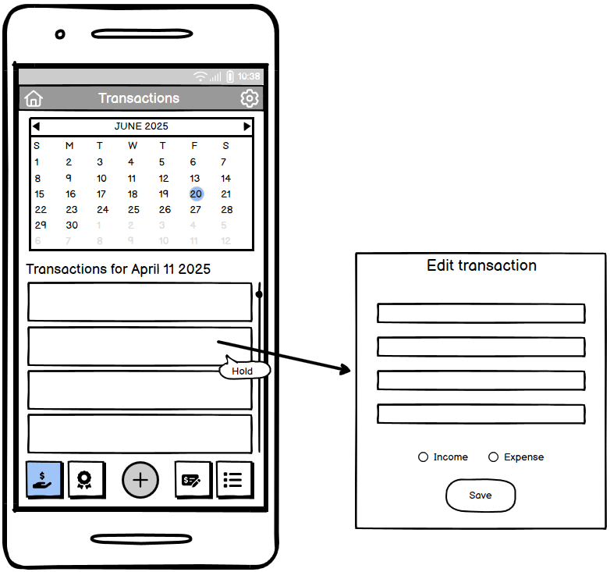
Prototype 0 - mockups
For our first prototype, we realized some mockups of the different screens to be realized in the application. Here are some of them.
Dashboard
Transactions screen

Slide 18
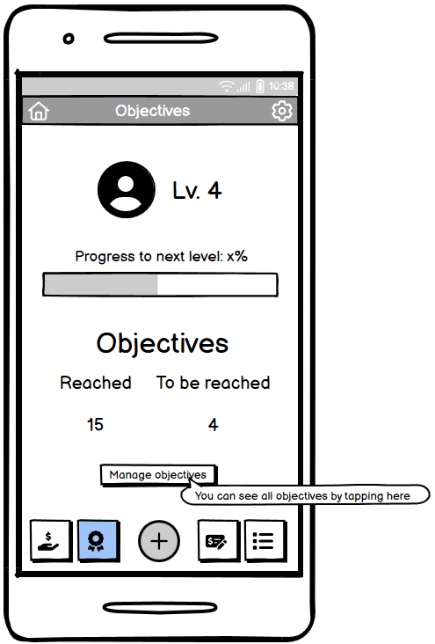
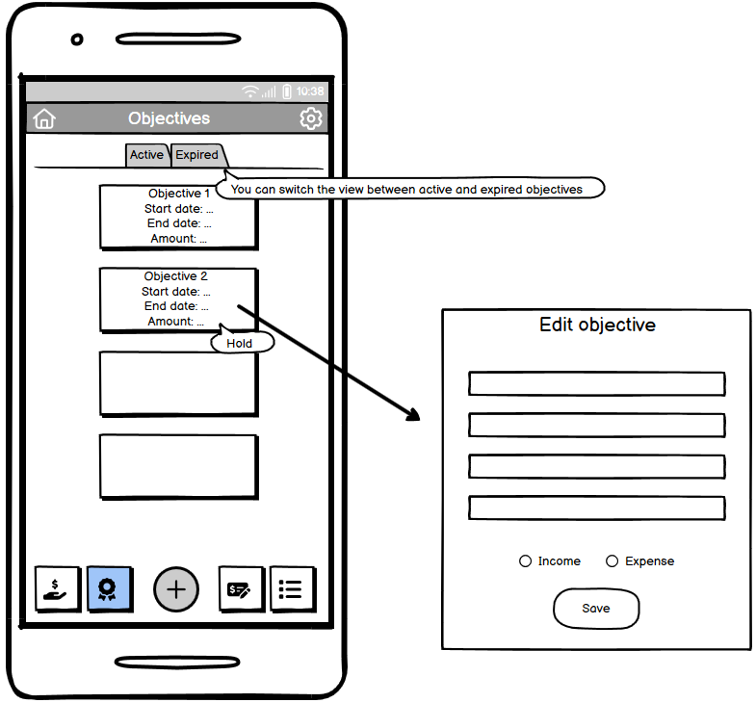
Prototype 0 - mockups
Objectives screen
Objectives management screen

Slide 19
EXPERT EVALUATION - HEURISTIC EVALUATION
We asked an expert to conduct heuristic evaluation on our prototype 0. Here are some of the more severe issues surfaced from the results.
Frame | Heuristic violated | Severity | Description / Comment
Transactions | Match between system and real word | 4 | Days with transactions lack clear visual cues, such as dots or highlights. Users must click randomly to find transactions, which does not meet real-world expectations of calendar design.
Categories | User Control and Freedom | 4 | No visible options to edit or delete existing categories. Users cannot modify incorrect category names or remove unused categories, which severely limits their control over the financial organization system.

Slide 20
EXPERT EVALUATION - HEURISTIC EVALUATION
Frame | Heuristic violated | Severity | Description / Comment
Transactions | Help Users Recognize, Diagnose, and Recover from Errors | 3 | Selecting a date with no transactions must show an empty list with a feedback (e.g., "No transactions on this day"). Otherwise, users may assume a technical error.
All Interfaces | Help & Documentation | 3 | There is a lack of contextual help and onboarding for first-time users.

Slide 21
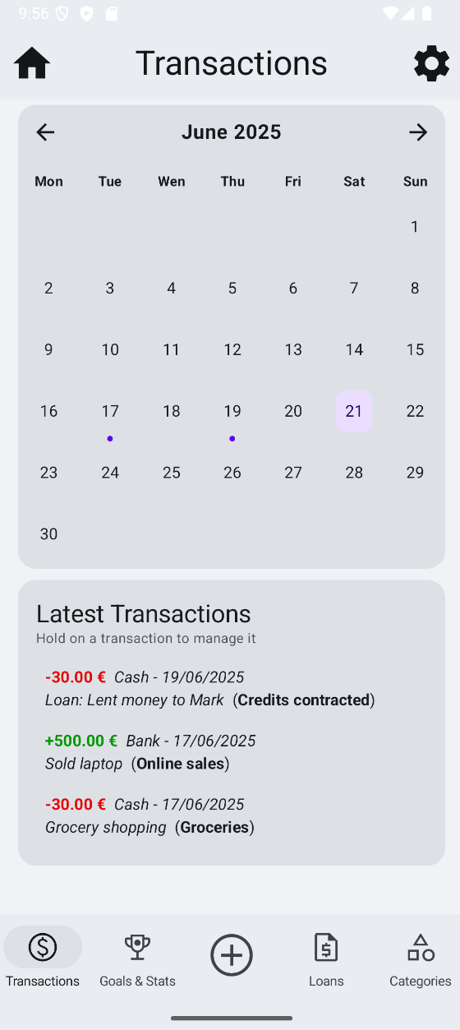
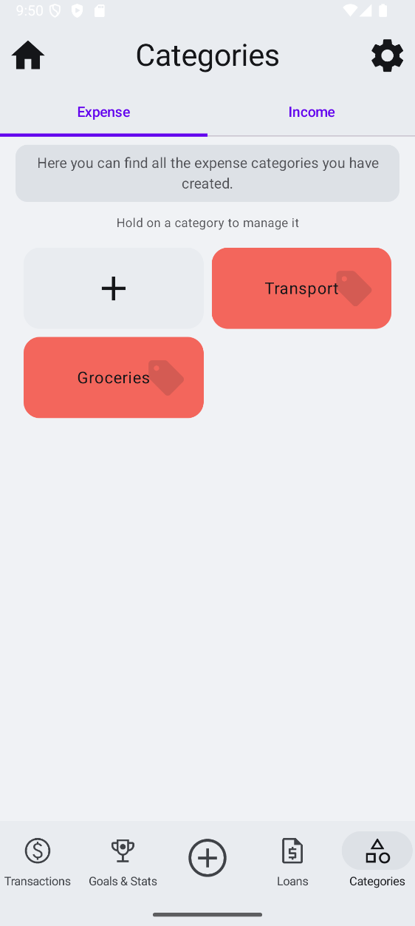
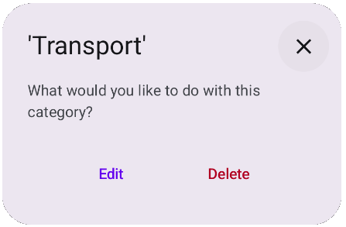
EXPERT EVALUATION - HEURISTIC EVALUATION
All the issues were promptly fixed. Here are the final screens related to the previously shown issues, with the implemented fixes. In particular:
The transactions screen now features an indication on the days that contain transactions
Categories can be edited and deleted, and it is clearly stated how to do so

Slide 22
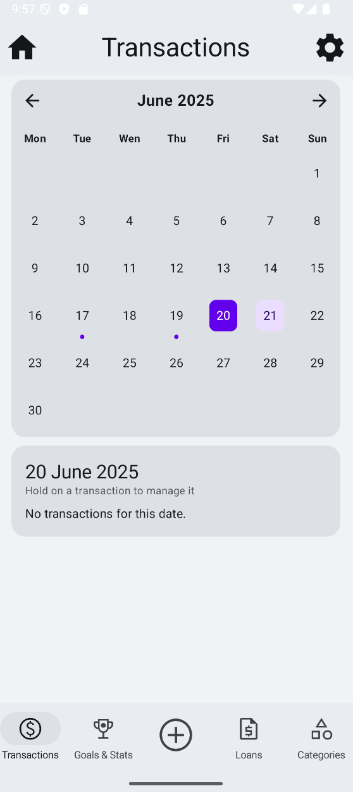
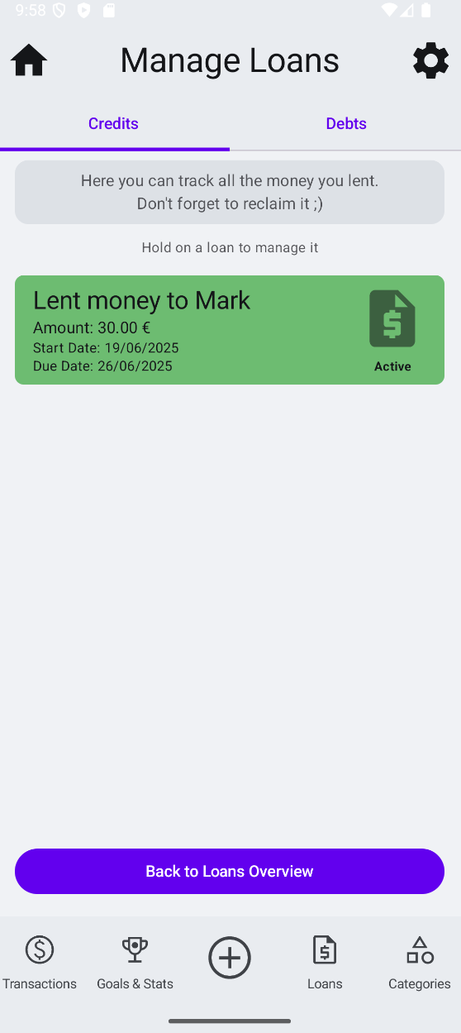
EXPERT EVALUATION - HEURISTIC EVALUATION
When selecting a day with no transactions, a message is displayed
In several interfaces, there is now a message the informs the user of the functionality of said interface; this should help first-time users

Slide 23
USER EVALUATION – think aloud
We conducted a think aloud evaluation, asking users to perform the following tasks:
Add a transaction
Set a PIN for secure access
Set a goal, mark it as reached and check your stats
The first two tasks were performed fairly easily. Thanks to the icons, the add button and the settings button were located quickly and from there the interaction continued as expected, with users inserting details for the addition of the transaction and for the setting of the PIN code.

Slide 24
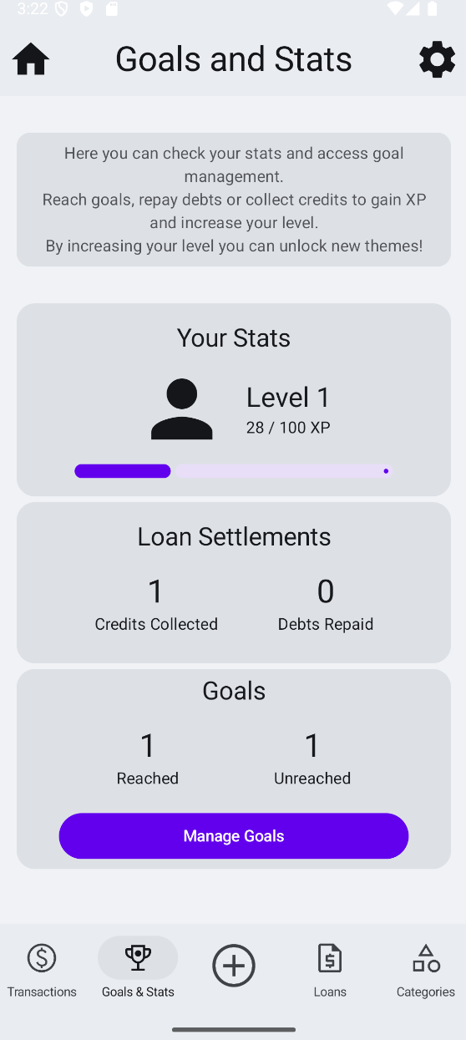
USER EVALUATION – think aloud
While conducting evaluation of the third task, we noticed that users had trouble locating the stats page, which is in the same section as the goals.
Therefore, we decide to rename objectives to «goals» and to rename the Objectives section to «Goals & Stats» to make it clearer.
While doing this we also added stats related to loans.

Slide 25
USER EVALUATION – controlled experiment
For the controlled experiment we designed two styles of interfaces for the navbar and the add dialog: one with labels and one with icons only.
We divided users in two groups and tested each group on one of the two interfaces. The task the users were asked to perform was the following:
Add a debt, then mark it as repaid and check your stats
We measured the time taken to complete the task for each user.
Group A: interface with labels
Group B: interface with icons

Slide 26
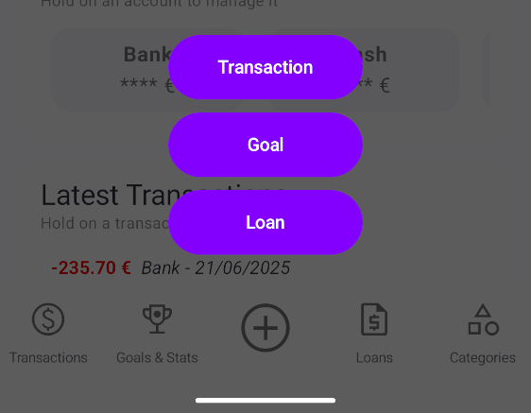
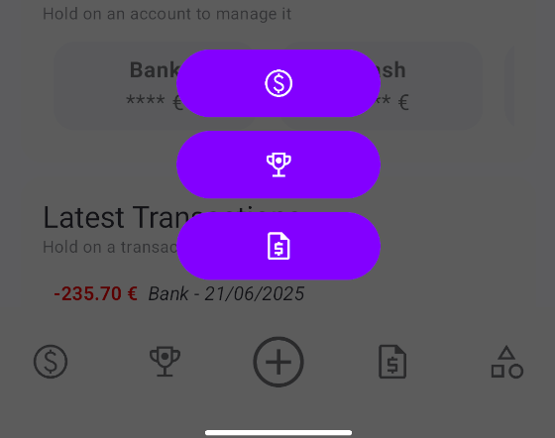
USER EVALUATION – controlled experiment
A: Interface with labels
B: Interface with icons

Slide 27
USER EVALUATION – controlled experiment
Time to complete the task
Summary
Groups | Count | Sum | Mean | Variance
Group A | 8 | 396 | 49,5 | 10,28571
Group B | 8 | 436 | 54,5 | 12,85714
Group A | Group B
46 | 53
48 | 56
54 | 51
47 | 58
50 | 55
52 | 49
46 | 54
53 | 60
47 | 56
49 | 52
ANOVA
Source of Variantion | SS | df | MS | F | P-value | F crit
Between groups | 100 | 1 | 100 | 8,641975 | 0,010762558 | 4,60011
Within groups | 162 | 14 | 11,57143
Total | 262 | 15

Slide 28
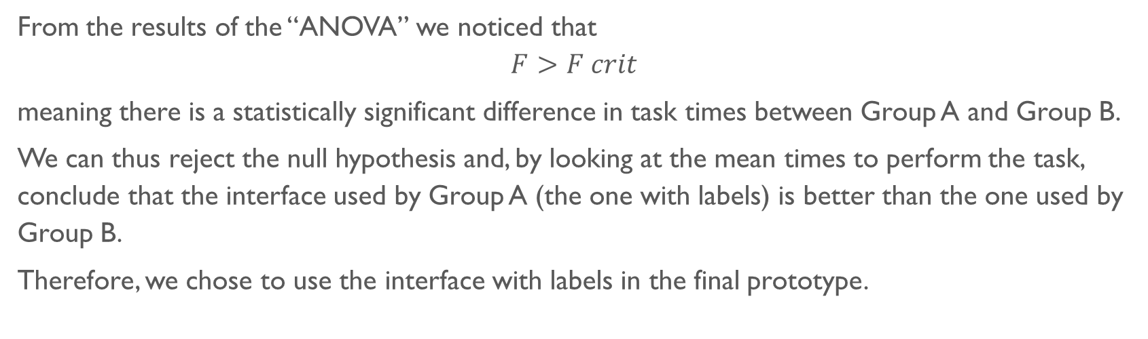
USER EVALUATION – controlled experiment
From the results of the “ANOVA” we noticed that
$$F>F crit$$
meaning there is a statistically significant difference in task times between Group A and Group B.
We can thus reject the null hypothesis and, by looking at the mean times to perform the task, conclude that the interface used by Group A (the one with labels) is better than the one used by Group B.
Therefore, we chose to use the interface with labels in the final prototype.

Slide 29
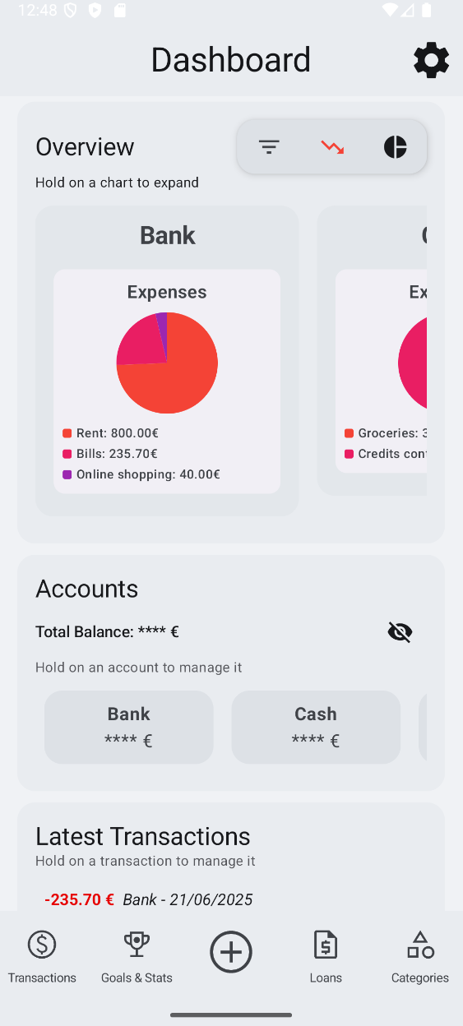
Final realization
The final product is an Android app with the following features:
Tracking and management of transactions, loans and goals
Transaction categorization
Graph visualization
Leveling system with rewards
Mechanism for secure access

Slide 30
Future work
Here are some ideas of improvements that could be made to Budgify to enrich the user experience.
Add more engaging rewards, to keep the user involved and entertained at the same time
Add support for multiple currencies, to grant the user a more customized experience with preferred currency selection
Provide more types of authentication, to enhance privacy
Add backup functionality, to let users securely export and store a copy of their financial data outside the app
Refine the interface, to improve user experience and system usability

